Slide 1
Cannabis: Market Trends and Developments
October 2023
Jose Becerril, Consultant – Tobacco & Cannabis

Slide 2
September 2023

Slide 3
Market Sizes: Challenges & Opportunites
The Cannabis Consumer
Cannabis in FMCG
Outlook

Slide 4
About Euromonitor International
Euromonitor International network and coverage

Slide 5
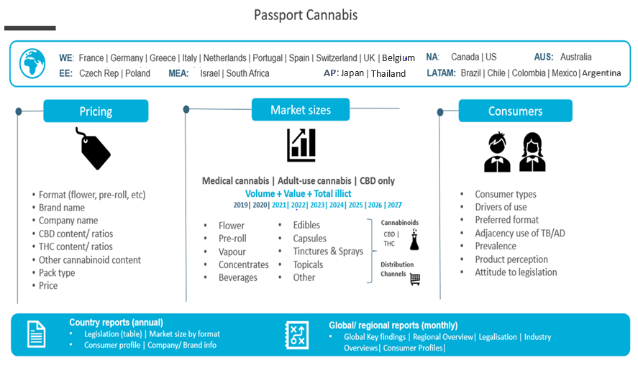
About Euromonitor International
Scope

Slide 6
Market Sizes: Challenges & Opportunites

Slide 7
2022 key figures
Market Sizes and Trends
80% = illicit consumption as share of global total
5.9 mio = number of CBD users
USD16.9 bn = value of US legal adult-use cannabis
Source: Euromonitor Passport Data

Slide 8
Medical
Adult-Use
CBD
Prescription-only
THC and/or CBD
Therapeutic use
USD 8.5 bilion
Non-prescription, regulated
THC (and possibly CBD)
Recreational use
USD 21 bilion
Non-prescription, regulated or not
CBD/Minor cannabinoids e.g. CBC, CBG
Therapeutic or recreational use
USD 11.5 bilion

Slide 9
Growing access and acceptance
Stigma remains
Regulatory uncertainty

Slide 10
The Cannabis Consumer

Slide 11
Anxiety Economy: Permacrisis
The cannabis consumer
Eco-Anxiety
Populist politics
Geopolitical tensions
Economic uncertainty
Notes:
It is no secret. We are living in uncertain times. The word of the year 2022 was „permacrisis“. After the pandemic, one crisis after the other. Consumers feel haunted by different crises.
The „Anxiety Economy“ refers to anything consumers might buy to attempt to deal with stress in their lives. (Broadly speaking these could be 3 categories, being medical and therapeutic solutions, then food and drink as medicine, other coping mechanisms /routines )
Various factors (listed on the right hand side) impact the economies of the world, but also everyday lives and consumer‘s mindsets. 2023 is a year where the climate crisis becomes even more visible to many people than before. Wildfires, droughts, floodings – such extreme weather events cause economic disruptions and impact consumer‘s thinking and wellbeing
Populist politics have not stopped after Trump or Brexit; populism is still on the rise esp. In times of economic uncertainty, people turn to more extreme politics. Populist politics has increased politcal uncertainty and instability.
Geopolitical tensions, not forgetting to mention last year Russia‘s invasion of the Ukraine and its contiuing war, but also rising tensions between China and the US, between emerging nations and „the West“ and the changing shifts in the world-order as many have known it for decades.
Last but not least – inflation. Empty shelves, disrupted supply chains, increasing prices mainly in food and energy – all those affect consumers and their daily lives.
On the left side – chart adults (divided by age groups, from 15-19 to 60+ years of age) rport that stress/anxiety has a „severe“ impact on their every day life (2022)
People feel evermore stressed. Especially young age groups experience high levels of stress or anxiety.
In times where people are becoming more aware of their mental health and care about things such as having a work-life balance, eating healthier and doing more sports – any thing that supports their mental health. Consumers are looking for products that support their goal of feeling better, that includes besides wellbeing (a good sleep e.g.) and physical health (such as the absence of pain, being hydrated, recovered etc) also emotional and mental health - feeling mentally ok

Slide 12
A range of existing and emerging need states in play
The cannabis consumer
Anxiety
Connect
Mindfulness
Calm
Stress
Anti-inflammation
Sleep
Reboot
Relaxation
Declutter
Pain-relief
Immunity
Arousal
Indulgence
Refuel
Cognitive function
Harm reduction
Post-workout
Gut health
Cocooning
Balance
Nourishment
Focus
Control
Energy
Hydration
Emotional/Mental
Physical

Slide 13
Mental Wellbeing
°1
°2
°3
Mood/ Relaxation
Stress management/ Stress relief
Sleep aid
Note: Reason for Consumption, Shown to respondents who consume adult use cannabis, living in markets/states where consumption is legal, Voice of the Consumer: Cannabis Survey, n=615 (2022)

Slide 14
The cannabis consumer
Non-smokeable formats will gain shares
Note: Reason for Avoiding Smokeable Formats, Shown to respondents who consume adult use cannabis, living in markets/states where consumption is legal, Voice of the Consumer: Cannabis Survey, n=86 (2022)
Source: Euromonitor Passport Data

Slide 15
Cannabis in FMCG

Slide 16
FMCG
Further legalisation of adult-use cannabis would have significant implications for other FMCG
Notes:
Wider availability of adult-use cannabis has the potential to impact a broad range of other FMCG industries meaning that brand owners and participants in these sectors should consider whether adult-use cannabis is aligned or antagonistic with ongoing consumption of their portfolio. Euromonitor’s Cannabis Survey asks consumers to project what impact, if any, legalisation would have on their use of existing products areas.
At a global level, respondents reported that, in the event of adult-use legalisation, the largest decrease in their consumption habits would revolve around the use of analgesics and sleeping pills. This aligns with data on the key consumption missions for existing adult-use consumers in terms of pain management and sleep.
The majority of consumers also reported that they would consume much or a little less alcohol and tobacco products were adult-use cannabis to be legalised. This mirrors data from the survey that shows around one in five adult-use cannabis consumers of tobacco and one in three of alcohol have either stopped or reduced their consumption of those substances as a result of their cannabis use.

Slide 17
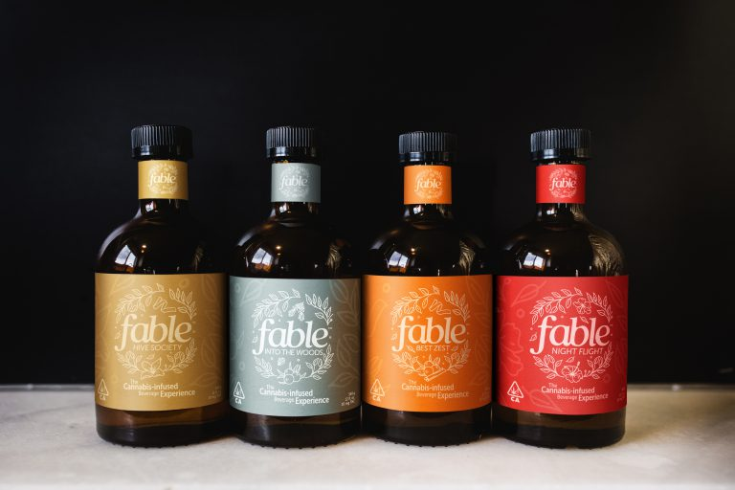
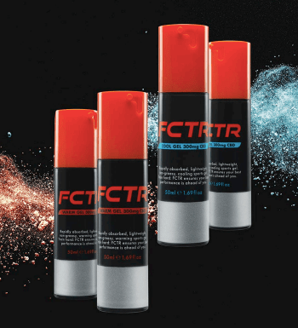
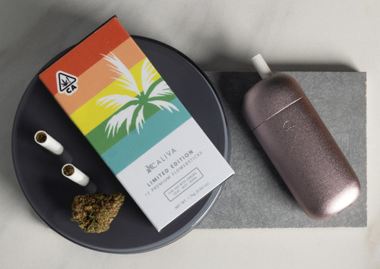
Innovation in cannabis goes beyond tobacco products and reaches topicals, beverages or edibles
Range of four cannabis-infused botanical beverages from BKKB Ventures LLC
VUSE CBD Zone
Alcoholic and non-alcoholic beverages
Processed food
Heated tobacco and vaporisers
Body care
Consumer Health
Topicals
CBD sports gel range from Cronos
New Caliva Flowersticks
New range of cannabis sugar confectionery gummies under the DELI Dimes brand
Image source: bevnet.com, bat.com, cannabiz.com.au, newcannabisventures.com, packagingstrategies.com

Slide 18
Outlook

Slide 19
North America sales forecast anticipates the potential of cannabis globally
OUTLOOK
Source: Euromonitor Passport Data
Source: Euromonitor Passport Data

Slide 20
Growth in legal cannabis sales reduces attractiveness of illicit trade
OUTLOOK
1/3
Of cannabis sales are projected to be legal by 2027, up from one tenth in 2019
Source: Euromonitor Passport Data
Source: Euromonitor Passport Data

Slide 21
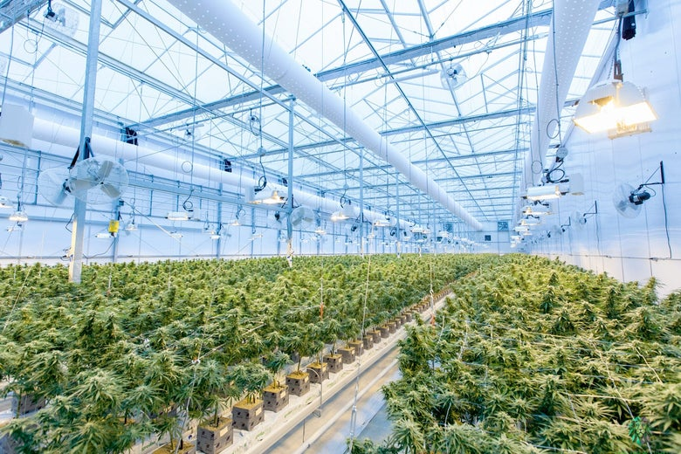
Cannabis cultivation set to provide opportunities for tobacco growers
OUTLOOK
INDOOR GROWING
The vast majority of legal cannabis (c.90%) is grown in indoor cultivation facilities which have the potential to be uniquely environmentally impactful given the incurred combination of energy usage for light and heat, significant water employment and the circulation of carbon dioxide to accelerate plant growth.
1/3
Of cannabis sales are projected to be legal by 2027, up from one tenth in 2019
Image source: www.mjbizdaily.com

Slide 22
Your thought leadership matters!
Complete the survey and receive a free copy of "Top 10 Global Consumer Trends 2023“ and an additional discount code for a Euromonitor report of your choice.

Slide 23
Thank you!
Jose Becerril, Consultant for Tobacco & Cannabis
Jose.becerril@euromonitor.com
Linkedin.com/jose_becerril

