Slide 1
Conference of the Parties to the WHO Framework Convention on Tobacco Control October, 2023

Slide 2
WHO and FCTC Overview
Demand reduction.
Supply reduction.
Article 5.3.
WHO
“Health for all”
World Health Assembly
(annual meeting)
Executive Board
(biannual meetings)
FCTC
“Tobacco end-game”
6 Regional offices
194 Member States
Conference of the Parties
(every two years)
Obligations and guidance via
Decisions.
Guidelines.
Protocols (e.g. Illicit trade - MOP).
147 country offices
183 Parties

Slide 3
WHO and FCTC Overview
COP 1: 06 - 17 February 2006, Geneva, Switzerland.
COP 2: 30 June - 06 July 2007, Bangkok, Thailand
COP 3: 17 - 22 November 2008, Durban, South Africa.
COP 4: 15 - 20 November 2010, Punta del Este, Uruguay.
COP 5: 12 - 17 November 2012, Seoul, Republic of Korea.
COP 6: 13 - 18 October 2014, Moscow, Russian Federation,
COP 7: 07 - 12 November 2016, New Delhi, India.
COP 8: 01 - 06 October 2018, Geneva, Switzerland.
COP 9: 08 - 13 November 2021, Geneva, Switzerland.
COP 10: 20 Nov - 25 Nov 2023, Panama City, Panama.
Entered into force on 27 February 2005
Conference of the Parties (COP) held every two years.
FCTC 2030 project to support LMICs
NGO created explicitly to support the development, ratification, and implementation of the WHO FCTC.
NGO created explicitly to support the development, ratification, and implementation of the WHO FCTC.

Slide 4
FCTC Overview
Key Actors and Backdrop
COP
Decision-Making Body
Parties (Governments)
Civil Society Anti Tobacco Organizations
FCTC Secretariat
COP Bureau
TobReg
TobLabNet
Collaborating Centres
WHO
DG | WHA | EB
WHO Regions

Slide 5
FCTC Overview
Main Articles
ARTICLE 2.1
Measures beyond those required by the Convention and its protocols
Smoke-free generations, tobacco endgame strategies.
ARTICLE 5.3
Protection of health policy from industry interests.
GUIDELINES: Limit government interaction with tobacco industry, regulate corporate social responsibility activities.
ARTICLE 6
Price and tax measures to reduce demand.
GUIDELINES: recognize state sovereignty in taxation but refers to taxes accounting for 70% of retail price and earmarked taxes.
ARTICLE 8
Protection from exposure to tobacco smoke.
GUIDELINES: All people should be protected from exposure to tobacco smoke. All indoor workplaces and indoor public places should be smoke free.
ARTICLE 9 AND 10
Require disclosure & regulation of contents and emissions.
PARTIAL GUIDELINES: Ban on ingredients to reduce attractiveness; require disclosure of content and emissions.
ARTICLE 11
Health warnings and descriptor bans.
GUIDELINES: Health warnings according to risk profile; minimum 50% health warnings and plain packaging.
ARTICLE 12
Education, communication, training and public awareness.
GUIDELINES: Educate people on consequences of tobacco consumption & exposure to smoke.
ARTICLE 13
Advertising, promotion and sponsorship bans
GUIDELINES: Subject to national law, ban on advertising (all channels), and sponsorship, including ban on POS display.
ARTICLE 14
Measures concerning tobacco dependence and cessation
GUIDELINES: Effective measures for cessation and dependence treatment.
ARTICLE 15
Prevention of illicit trade
PROTOCOL: Measures to regulate the supply chain, including licensing system, T&T, duty free sales and Free Trade Zones.
ARTICLE 17 AND 18
Alternative activities and protection of the environment
POLICY OPTIONS AND RECOMMENDATIONS: Economically sustainable alternatives to tobacco growing.
ARTICLE 19
Legislative action on criminal and civil liability, including compensation schemes, subject to national law.
Toolkit & Database of Experts.
No elaboration of harm reduction measures, although Article 1 identifies harm reduction as one of the three pillars of “tobacco control”

Slide 6
FCTC Overview
Driver of National Policy
151
22
countries have implemented ADVERTISING BAN
countries have implemented PLAIN PACKAGING
27
89
countries have implemented RETAIL DISPLAY BAN
countries have implemented PUBLIC SMOKING BAN
120
34
countries have implemented LARGE GW
countries have implemented MENTHOL BAN

Slide 7
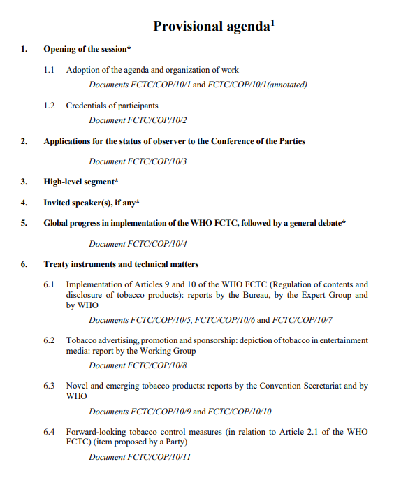
FCTC COP10
Agenda overview

Slide 8
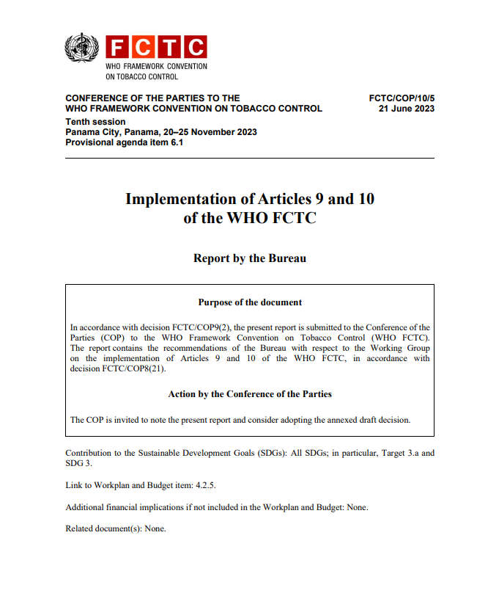
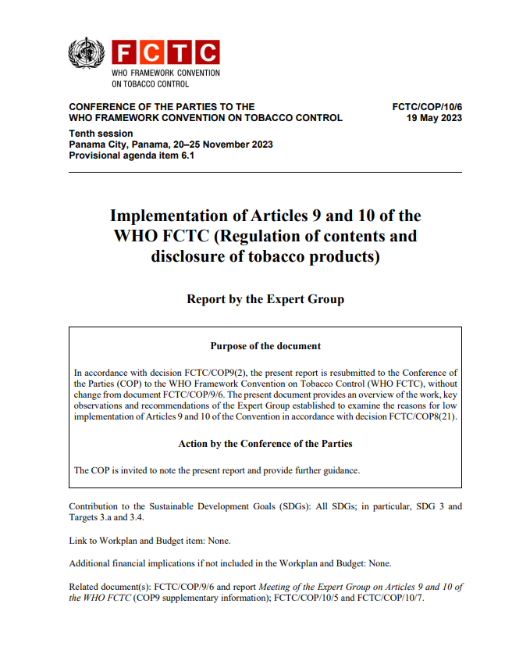
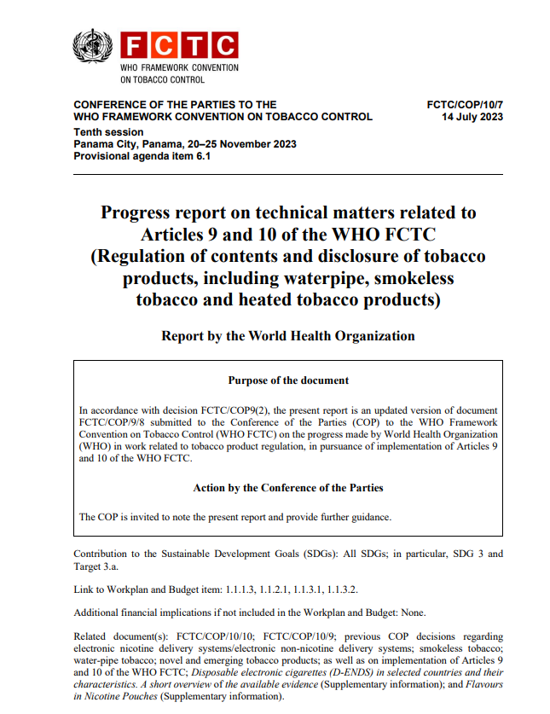
FCTC COP10
Policy recommendations
HTPs:
When not banned, fully apply FCTC provisions and recommendations in the WHO comprehensive report on HTPs and the FCTC Classification report.
Nicotine pouches:
Prevent all forms of marketing and take all action necessary to minimize youth access, appeal and initiation.
Regulate nicotine products in the same way as products of similar appearance, content and use (e.g. regulate nicotine pouches the same as snus)
Disposable e-cigarettes (D-ENDS):
Consider very strong regulations, which could include a ban, to protect children.
E-cigarettes (ENDS/ENNDS):
Where ENDS are not banned, prevent uptake by youth, and prevent availability and marketing to youth, including:
banning or restricting the use of flavours that appeal to minors;
banning or restricting flavours of serious toxicological concern e.g., diacetyl, acetyl propionyl, cinnamaldehydes or benzaldehyde;
requiring use of ingredients that are not risky to health and are of the ‘highest purity’.
Flavours:
Comprehensively ban or regulate flavouring agents in all nicotine and tobacco products to protect youth.
ARTICLES 9 AND 10

Slide 9
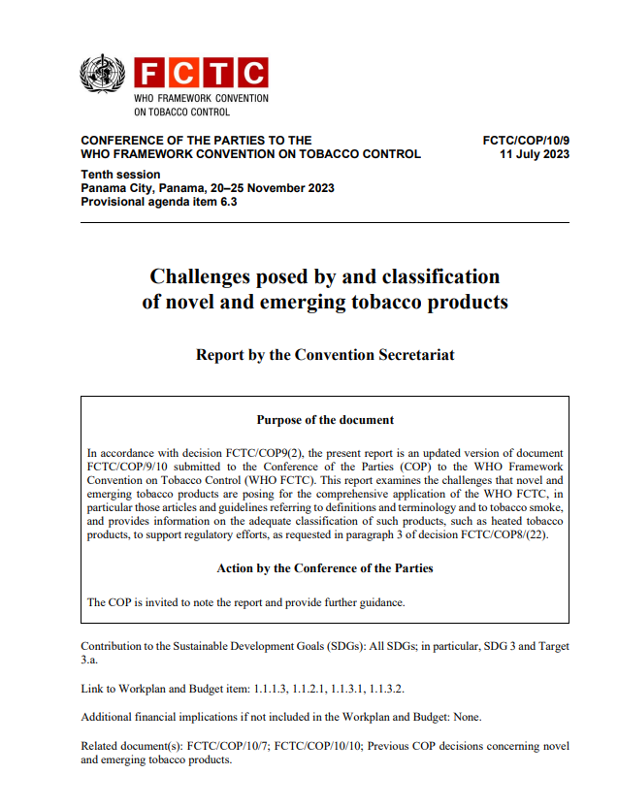
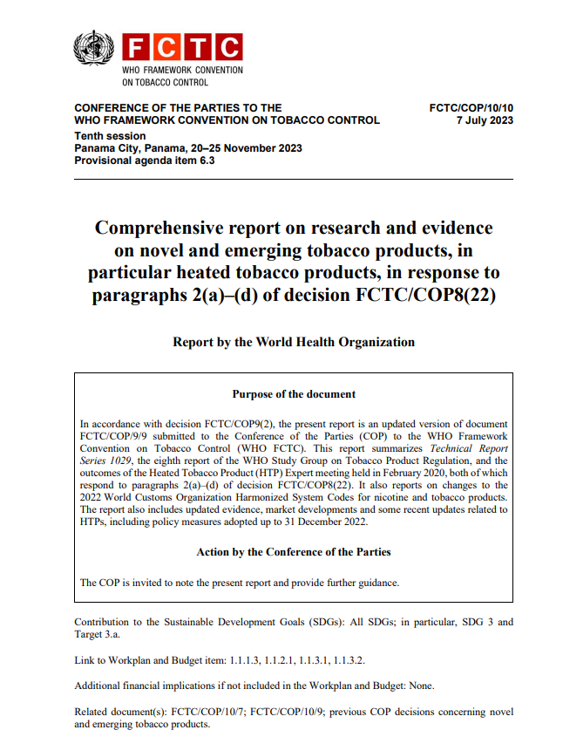
FCTC COP10
Policy recommendations
NOVEL AND EMERGING TOBACCO PRODUCTS
WHO Report on HTPs:
Regulatory provisions.
Apply existing regulations on conventional cigarettes to heated tobacco products, including:
Smoking bans
regulate the contents, emissions and design features of HTPs and require disclosure of the contents of HTPs in accordance with Articles 9 and 10 of the WHO FCTC, including restriction of the use of flavours that appeal to minors and prohibit the addition of pharmacologically active substances,
require large graphic health warnings and plain packaging on HTP consumable packs and device packages as for any other smoked tobacco products
apply existing bans on tobacco advertising, promotion and sponsorship to tobacco inserts and devices, and where this is not currently possible strengthen the law to ban all forms of advertising, promotion and sponsorship of HTP inserts and devices,
Fiscal provisions:
HTPs products should be taxed at the same rate as CCs,
Convention Secretariat Report on HTPs:
The aerosols emitted by HTPs thus fall under the definition of smoke. Since the source of this smoke is a tobacco product, the emissions of most novel and emerging tobacco products – including HTPs – are tobacco smoke.
All articles of the WHO FCTC and their guidelines for implementation can be applied to novel and emerging tobacco products, including HTPs, and extended to the devices needed for their use

Slide 10
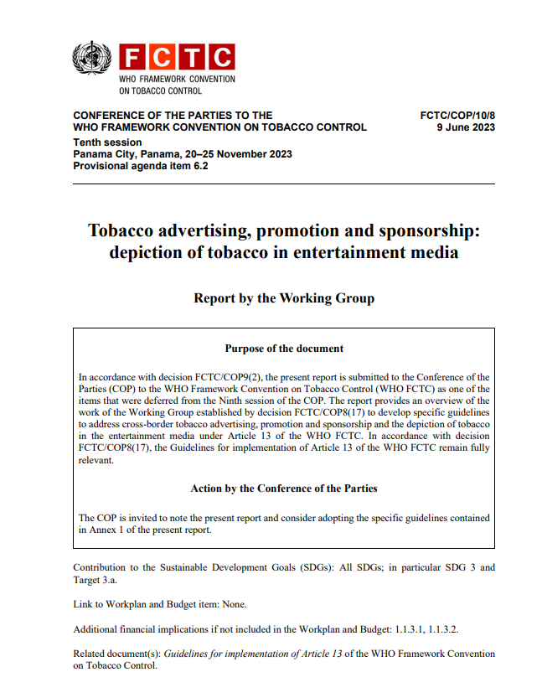
FCTC COP10
Policy recommendations
TOBACCO ADVERTISING, PROMOTION AND SPONSORSHIP
Draft guidelines:
The report provides an overview of the work of the Working Group established by decision FCTC/COP8(17) to develop specific guidelines to address cross-border tobacco advertising, promotion and sponsorship and the depiction of tobacco in the entertainment media under Article 13 of the WHO FCTC.
The draft specific guidelines attached to the report provides recommendations on inter alia:
Recommends Parties to ban RRPs, and to ban TAPS of all tobacco and nicotine products, including devices.
“Parties that have not prohibited the sale of novel and emerging tobacco products, should ensure a comprehensive ban on advertising, promotion and sponsorship of novel and emerging tobacco products, including devices used with them, the function of which is to enable the consumption of such products.”
Define all forms of communication with consumers as advertising, thus recommending banning all forms of commercial communications, including:
Digital media platforms
Corporate social media accounts (e.g. twitter, LinkedIn, Facebook, etc.)

Slide 11
Thank you

