Slide 1
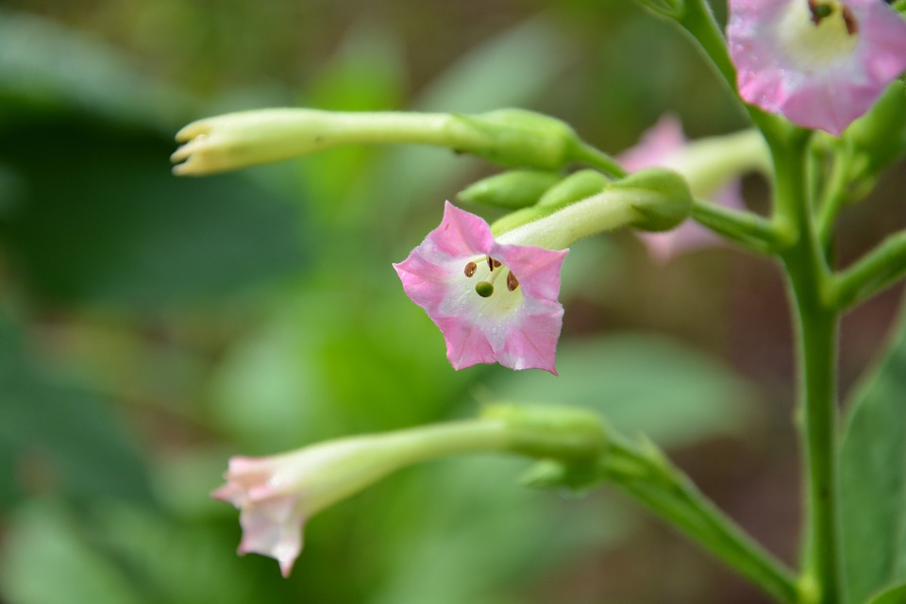
OVERVIEW ON TOBACCO PLANT DEFENSE
The current status and future perspectives
Speaker: Martina CAPPELLETTI

Slide 2
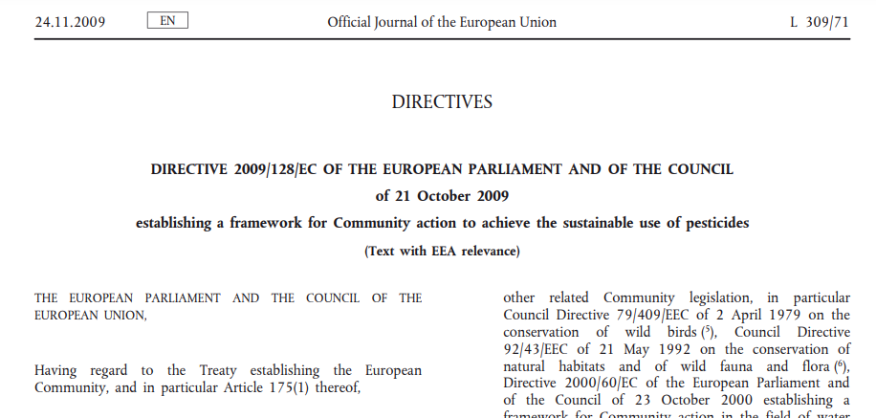
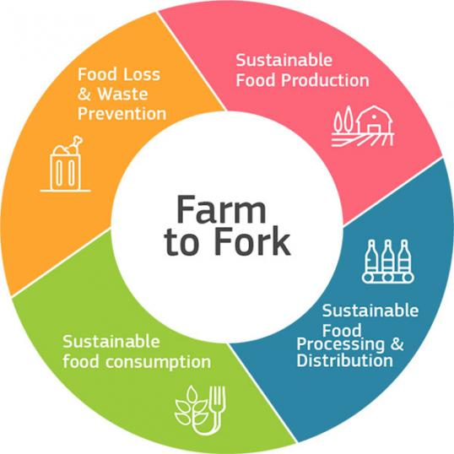
Overview on tobacco plant defense
A sustainable use of pesticides
CLIMATE
PACT AND CLIMATE
LAW
PROMOTING
CLEAN
ENERGY
INVESTING IN
SMARTER, MORE
SUSTAINABLE
TRANSPORT
PROTECTING NATURE
STRIVING
FOR GREENER
INDUSTRY
Plant protection products targets
The European
Green Deal
FROM FARM
TO FORK
ELIMINATING
POLLUTION
LEADING THE
GREEN CHANGE
GLOBALLY
ENSURING
A JUST TRANSITION
FOR ALL
MAKING
HOMES ENERGY EFFICIENT
FINANCING
GREEN
PROJECTS

Slide 3
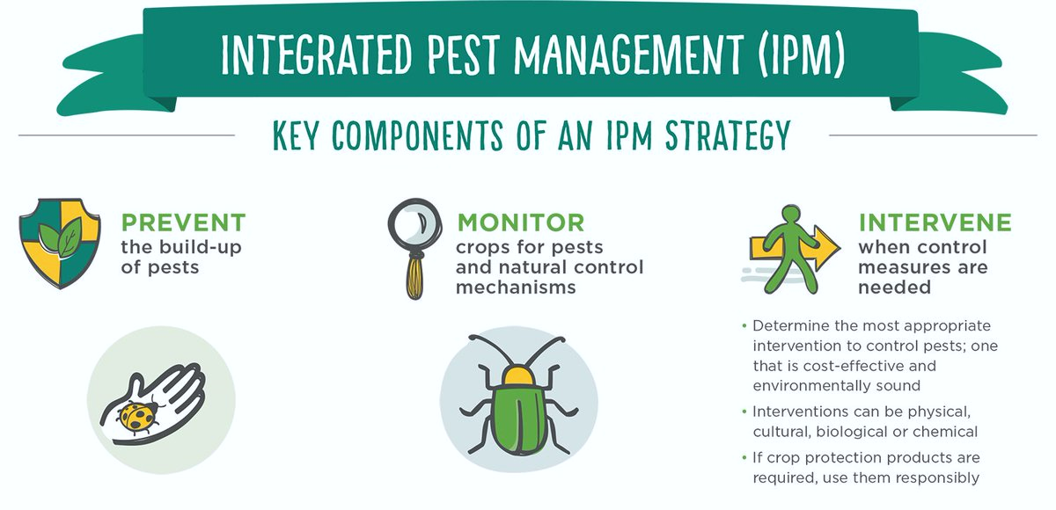
Overview on tobacco plant defense
A sustainable use of pesticides
DIR. 128/2009/EC
Pesticides (europa.eu)
In very sensitive areas (such as Natura 2000 sites, public parks and in the close vicinity of healthcare facilities and schools) the use of pesticides should be prohibited
Reduce by 50% the overall use and risk of chemical pesticides and reduce use by 50% of more hazardous pesticides by 2030
HARMONISED RISK INDICATORS
HRI-1
HRI-2
Member States shall take all necessary measures to
promote low pesticide-input pest management, giving
wherever possible priority to non-chemical methods

Slide 4
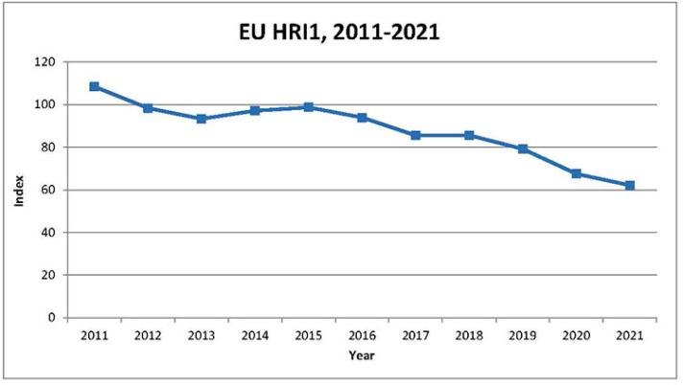
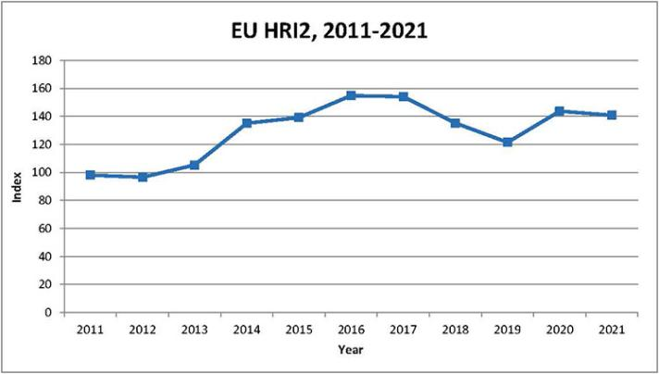
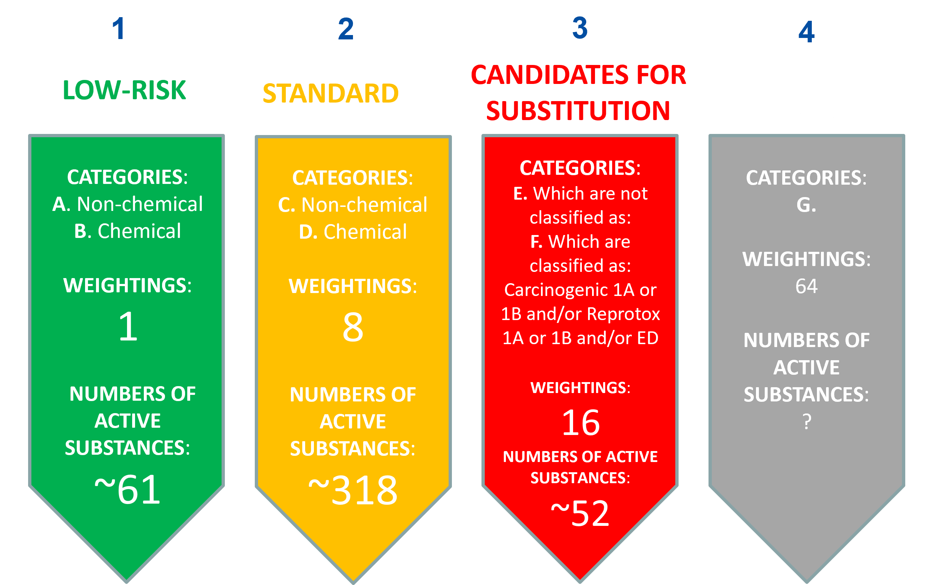
Overview on tobacco plant defense
HARMONISED RISK INDICATORS
HRI-1
HRI-2
Reduce by 50% the overall use and risk of chemical pesticides and reduce use by 50% of more hazardous pesticides by 2030
Notes:
gfgfgf

Slide 5
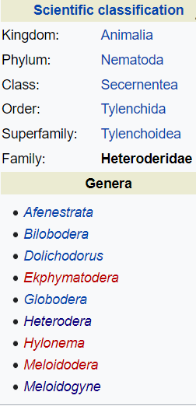
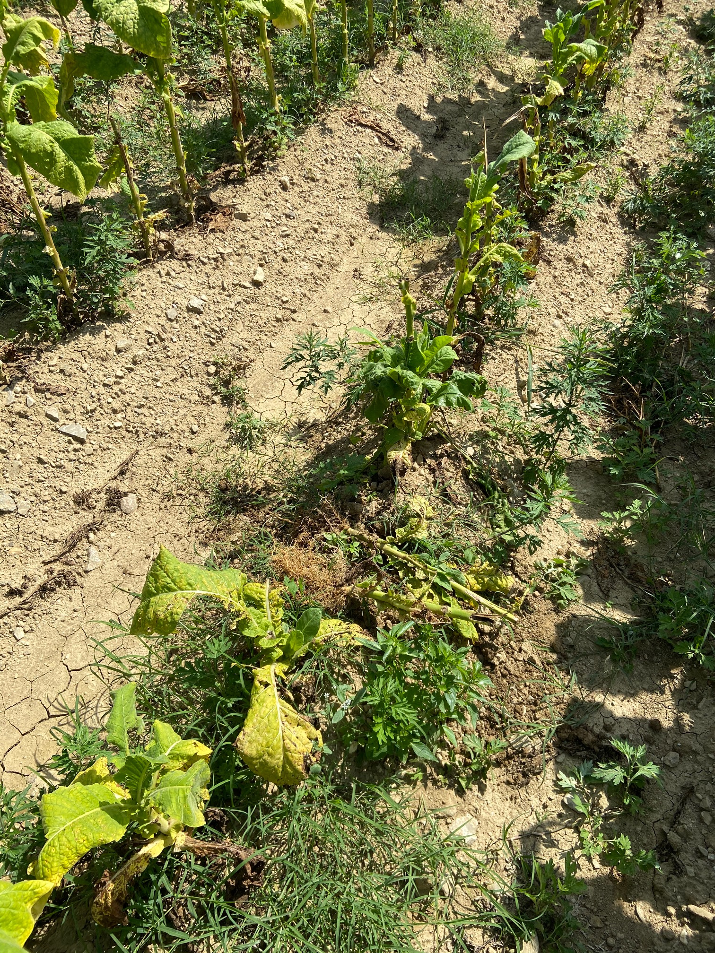
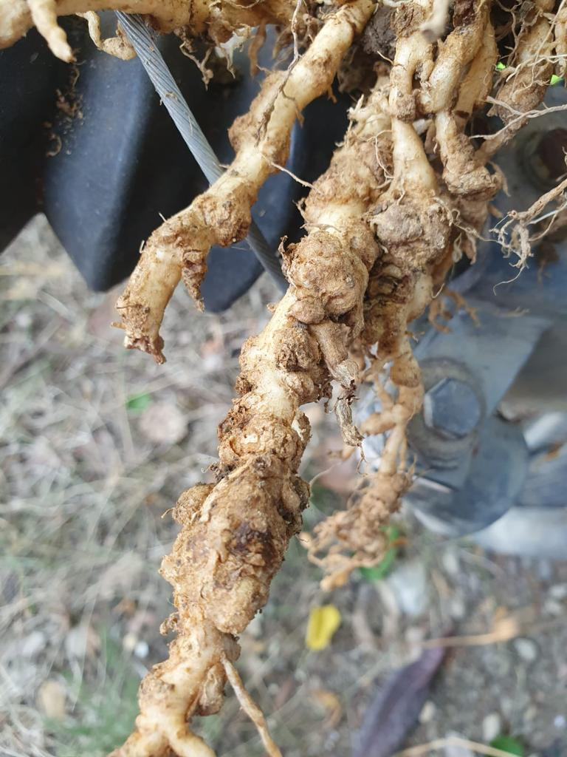
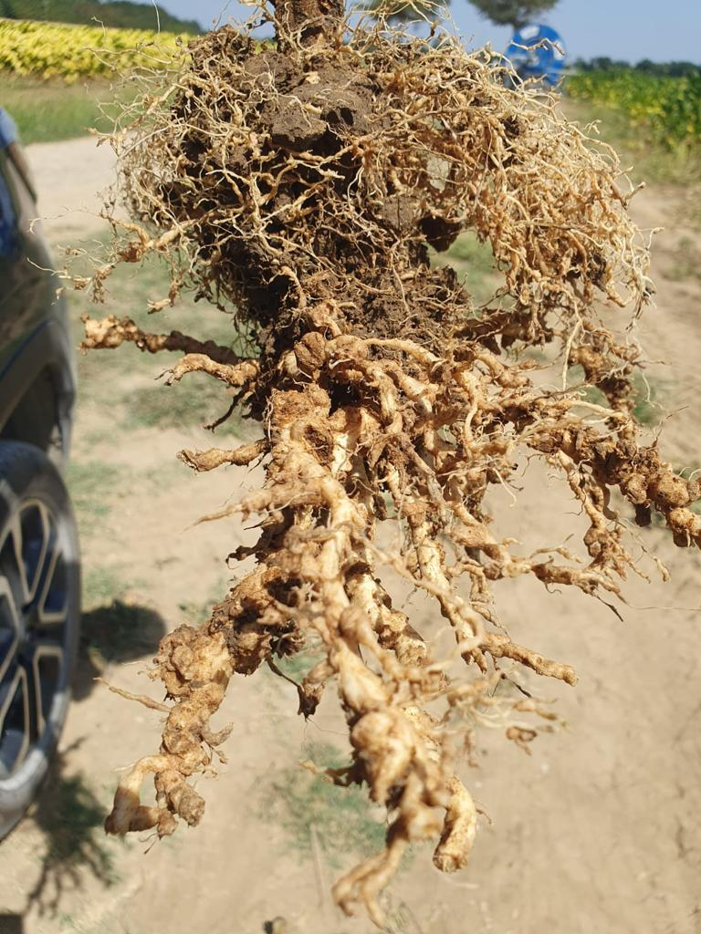
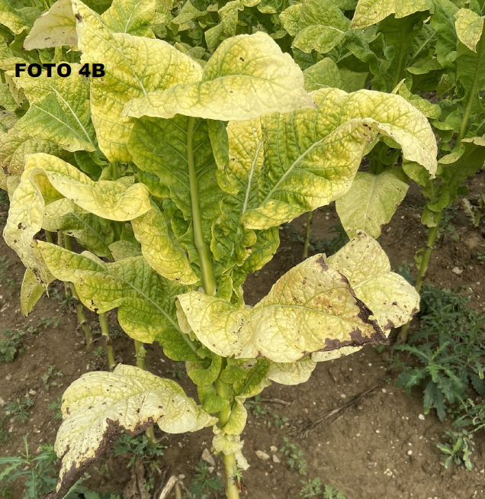
Overview on tobacco plant defense
1,3-Dichloropropene as soil fumigant nematocide
A case study

Slide 6
Overview on tobacco plant defense
1,3-Dichloropropene as soil fumigant nematocide
A case study
120 days emergency use authorization (Art. 53 Reg (CE) 1107/2009):
NECESSARY, BUT INCREASINGLY OPPOSED
High risk of mitigation measures (mulching)
2023
IT: 60 days
Delayed Authorization
ES: just on 2000 ha
2021
Applied only once every two years
2022
Request for hectares and zones
EU status: Not-approved

Slide 7
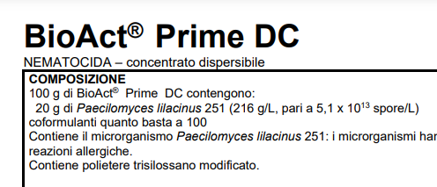
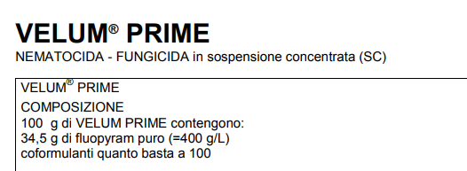
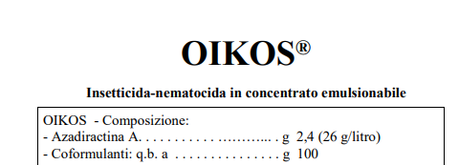
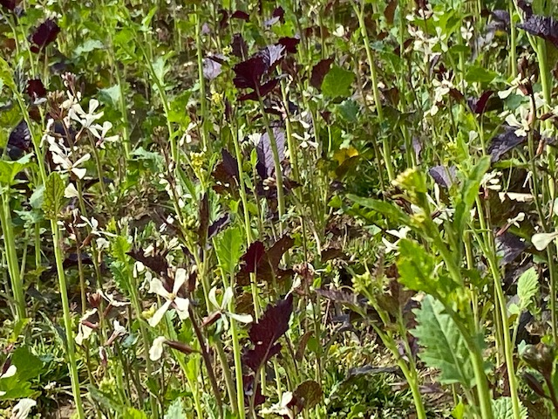
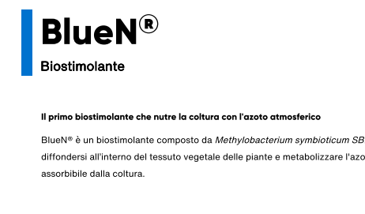
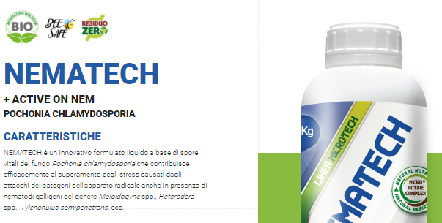
Overview on tobacco plant defense
1,3-Dichloropropene as soil fumigant nematocide
A case study
2024
-New data dossier
2025/2026/…
- New commercial product, with lower application doses
and mulching
notes

Slide 8
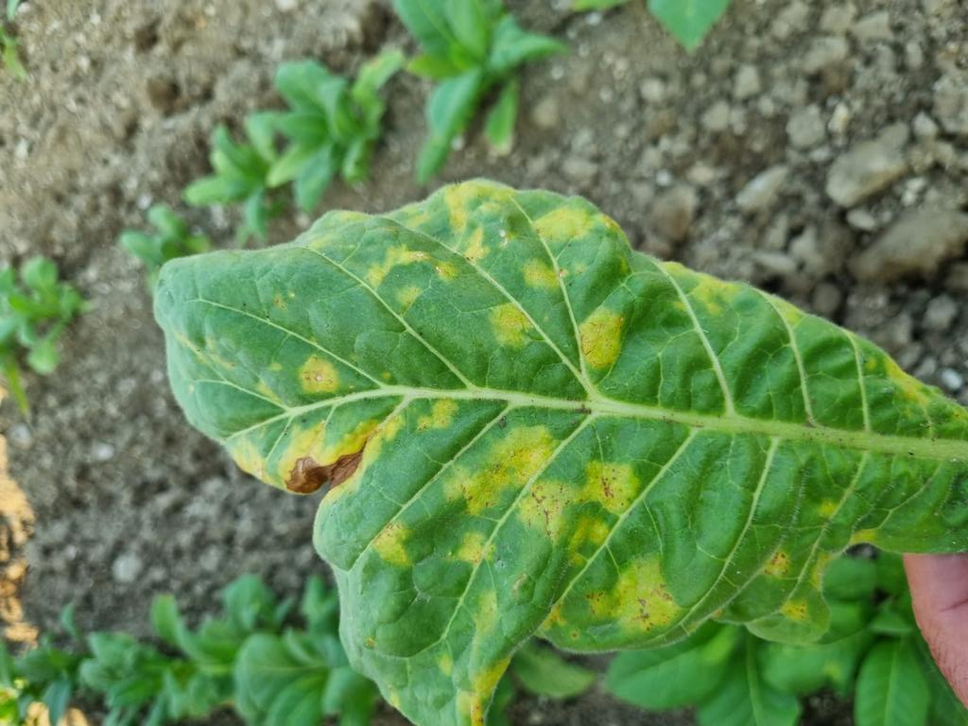
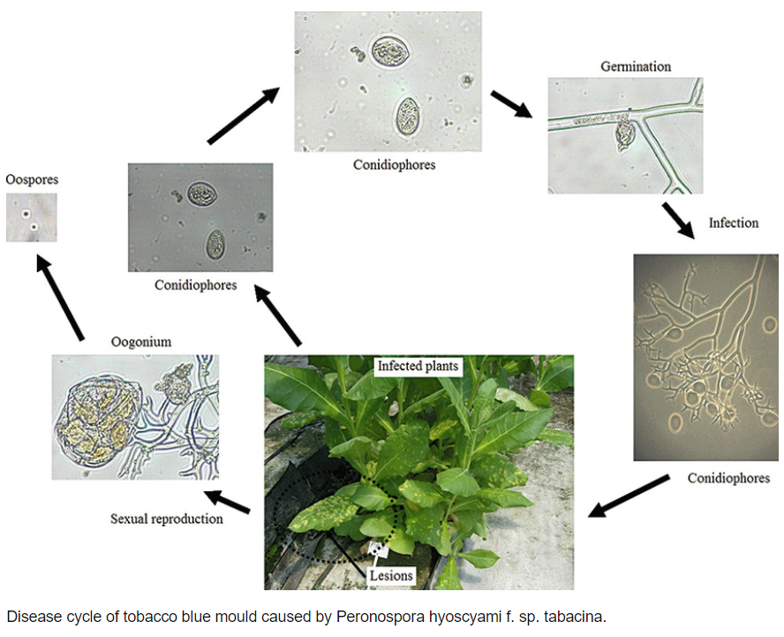
Overview on tobacco plant defense
The control of blue mold
Peronospora tabacina
Borras-Hildago et al., 2010

Slide 9
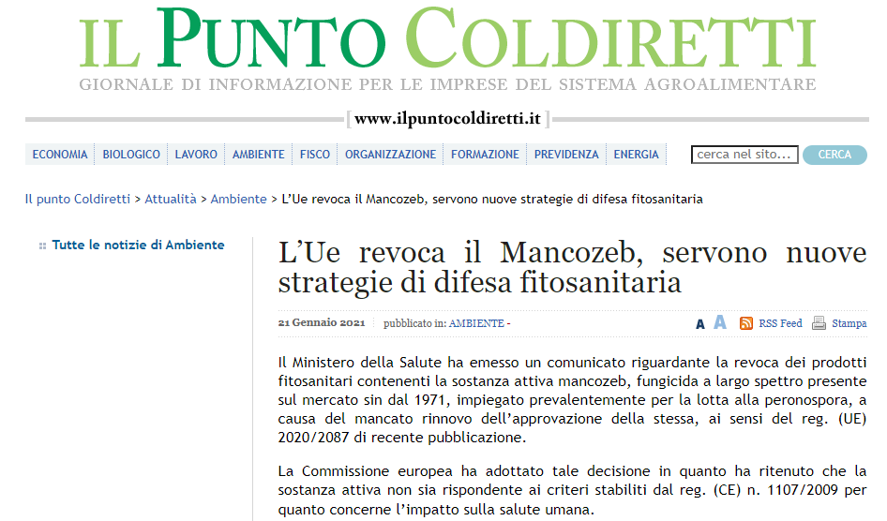
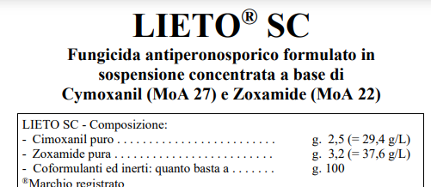
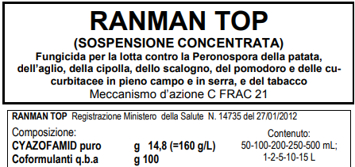
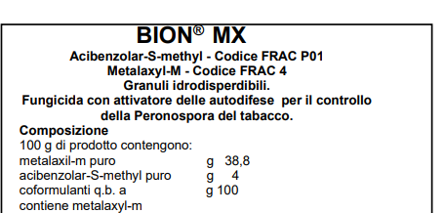
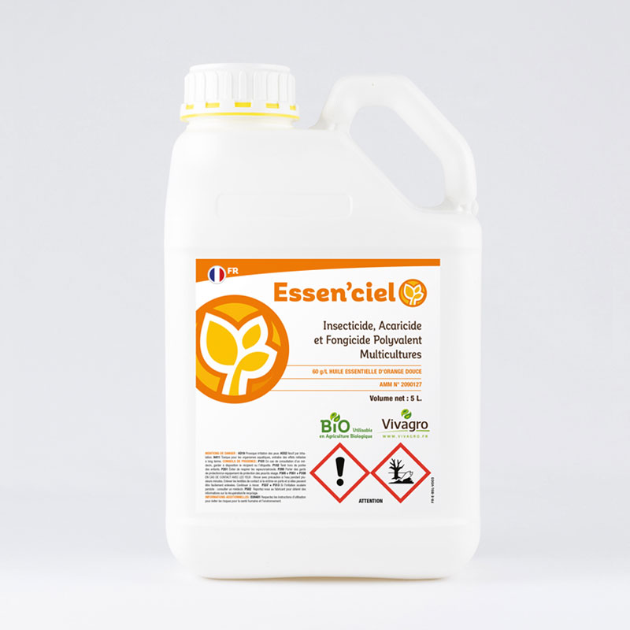
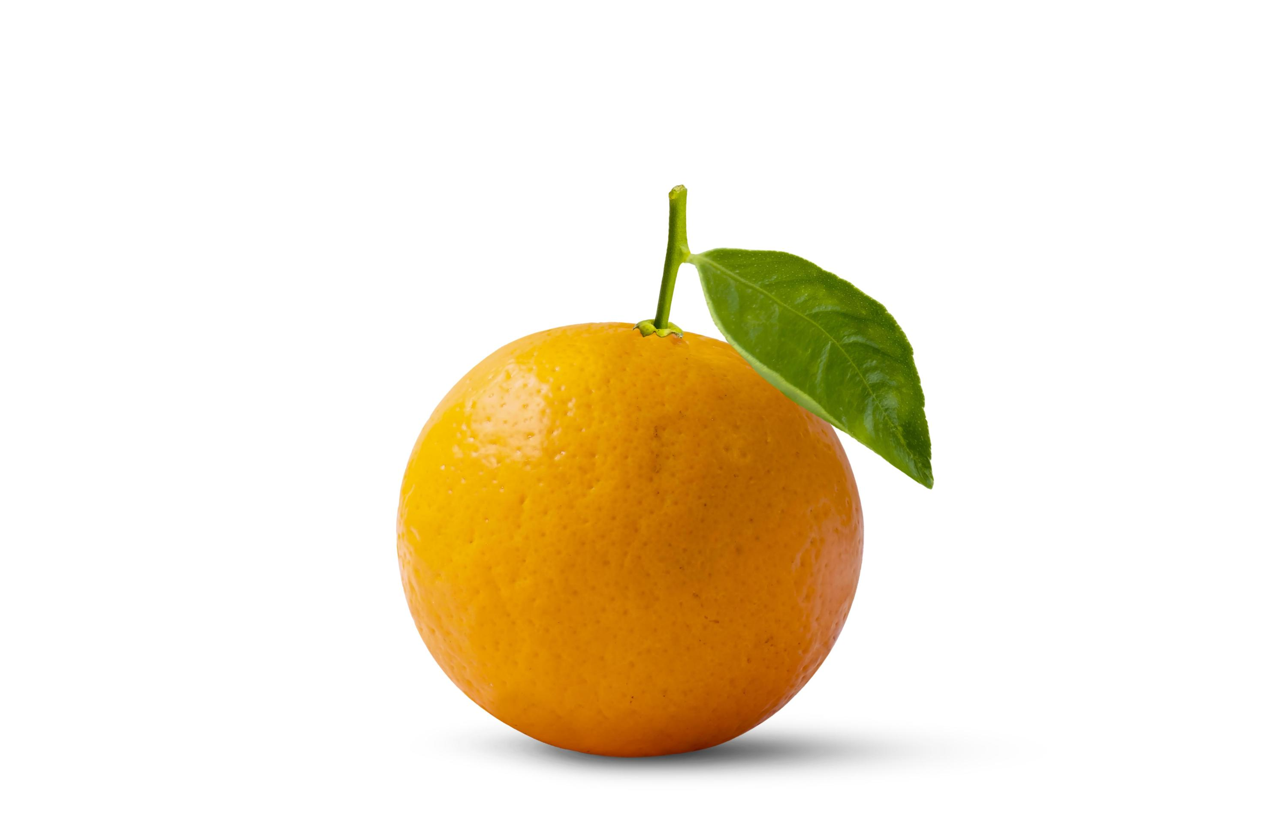
Overview on tobacco plant defense
The control of blue mold
Peronospora tabacina

Slide 10
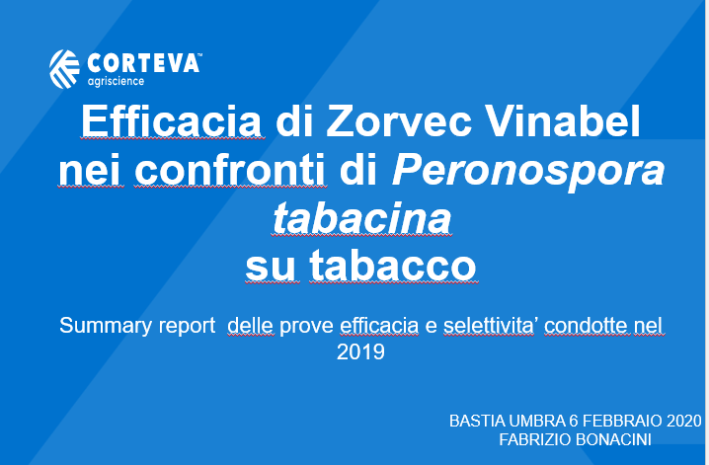
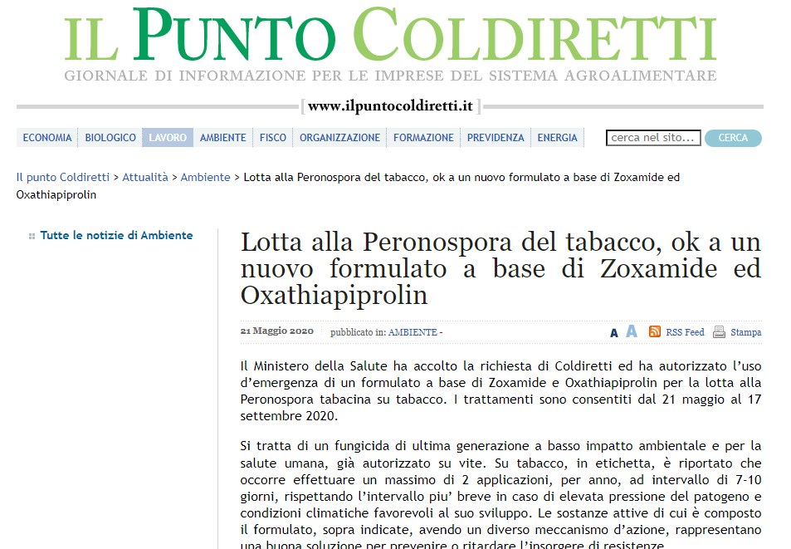
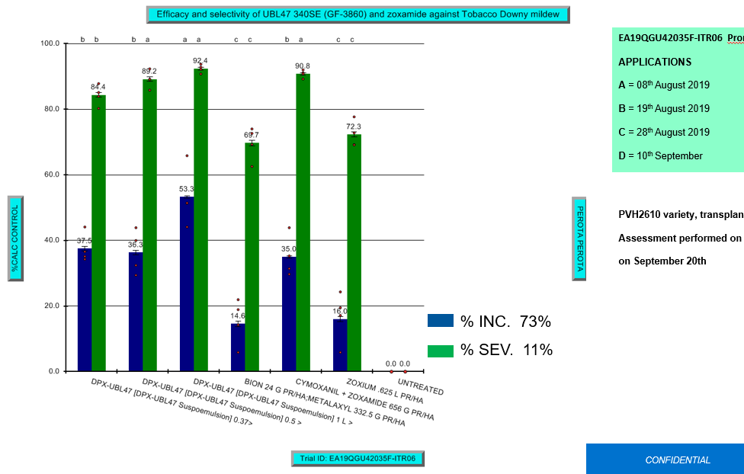
Overview on tobacco plant defense
The control of blue mold
Peronospora tabacina
- Decreasing interest from agro-chemical company to minor crops
- Tobacco-free ethical policy of Corteva
- Lack of authorized products = Higher risk of pathogen resistance
notes

Slide 11
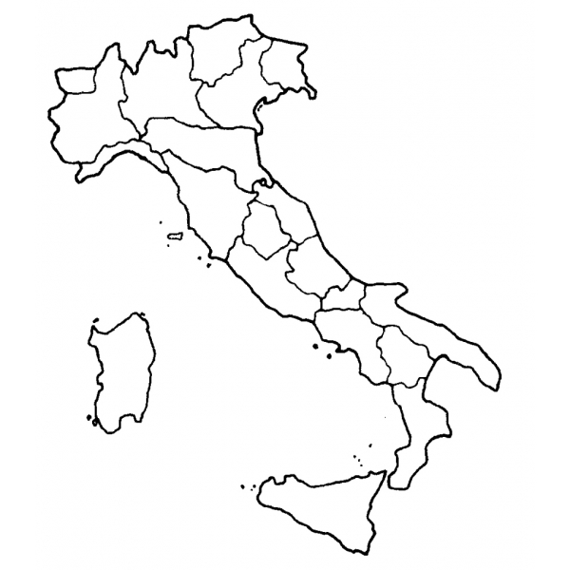
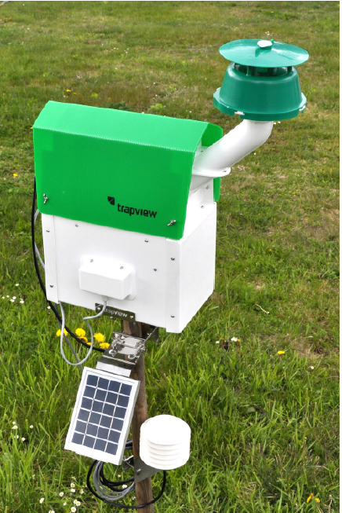
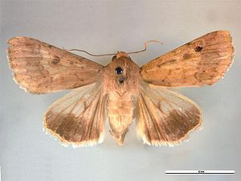
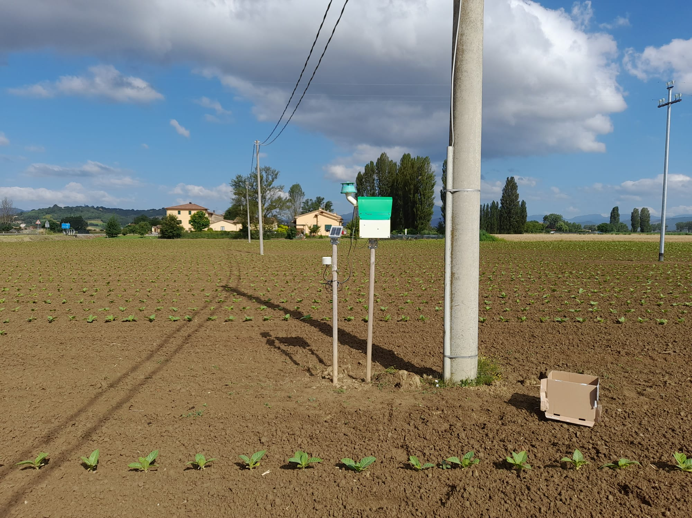
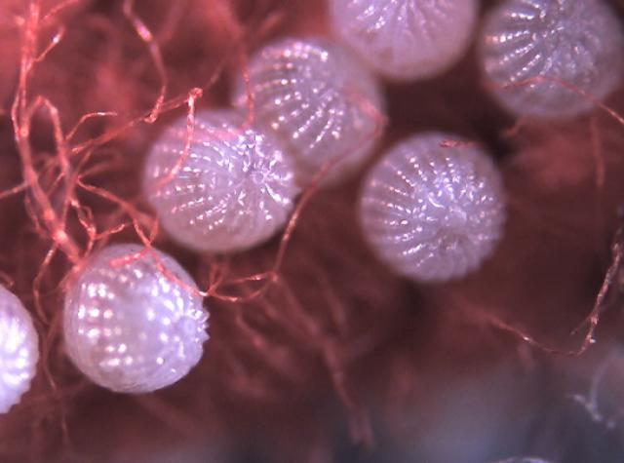
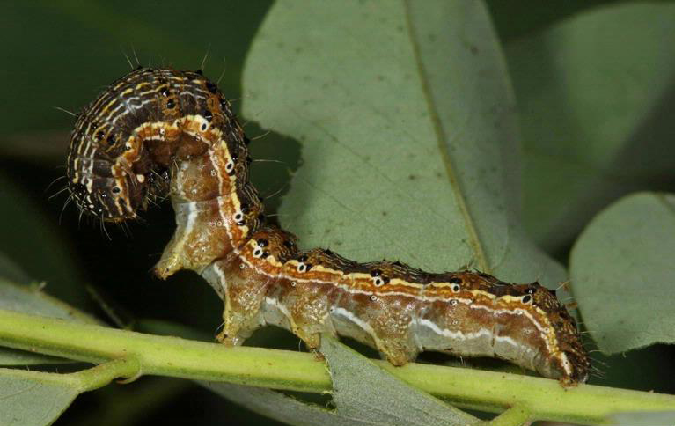
Overview on tobacco plant defense
Insects monitoring
by automatic pheremon traps and integrated pest managment
GOALS: ENVIRONMENTAL AND ECONOMIC SUSTAINABILITY
LIFE CYCLE Helicoverpa armigera and Mamestra brassicae
CORRELATION between number of adults and leaf erosion levels
BEST MOMENT for the phytosanitary intervention
- to optimise the effectiveness of the treatments
- to avoid resistance phenomena

Slide 12
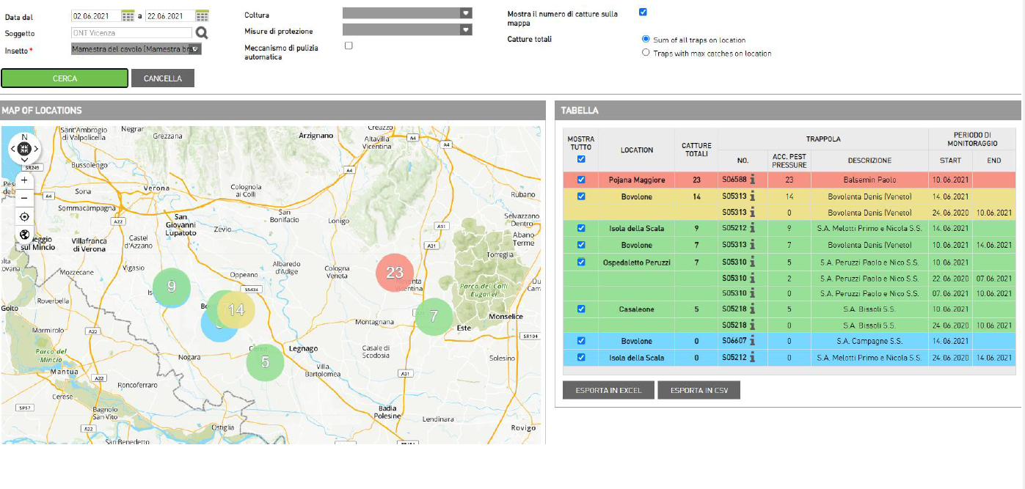
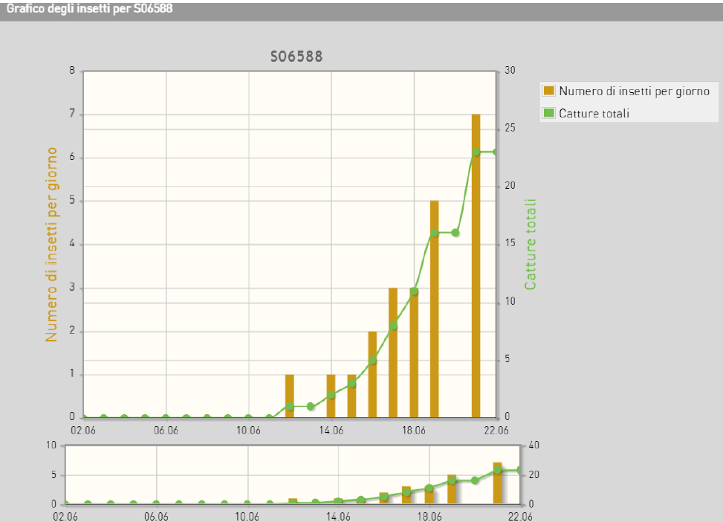
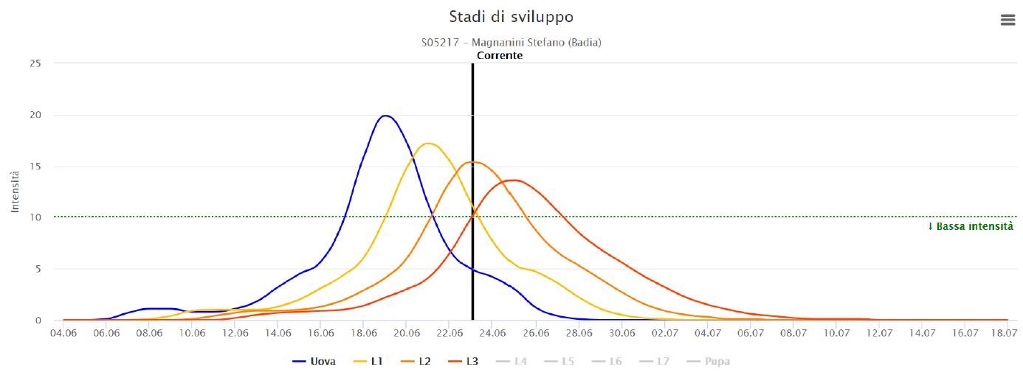
Overview on tobacco plant defense
Insects monitoring
by automatic pheremon traps and integrated pest managment
Traditional chemical based treatment
cp ALTACOR (a.i. Chlorantraniliprole)
PHYTOSANITARY DEFENSE PROTOCOL
Art. 53 Reg. (EC) 1107/2009
based on IPM
+
cp COSTAR (a.i. Bacillus thuringiensis var. Kurstaki strain SA12 )
Biocontrol based treatment

Slide 13
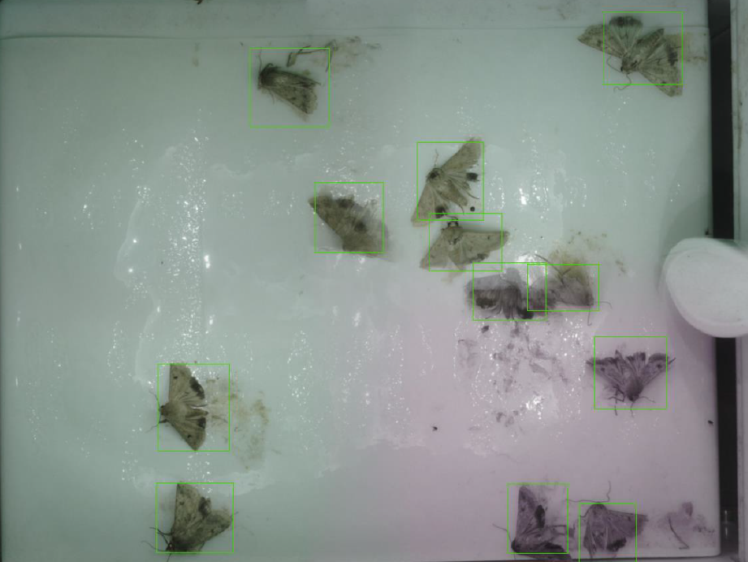
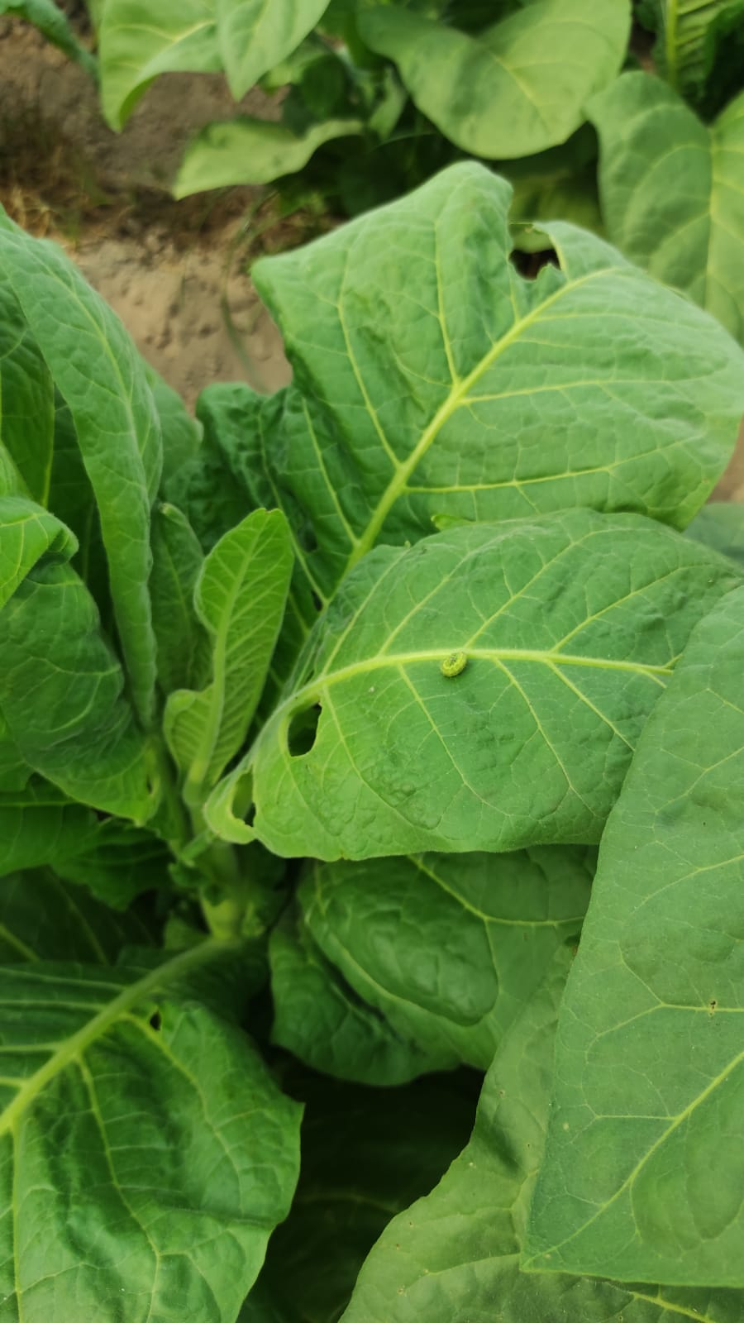
Overview on tobacco plant defense
Insects monitoring
by automatic pheremon traps and integrated pest managment
LOW-RISK SUBSTANCES
- Effective just if in combination with traditional active ingredients
- Very technical use (attention to: environmental conditions, pest life cycle,…)
- Expensive
notes

Slide 14
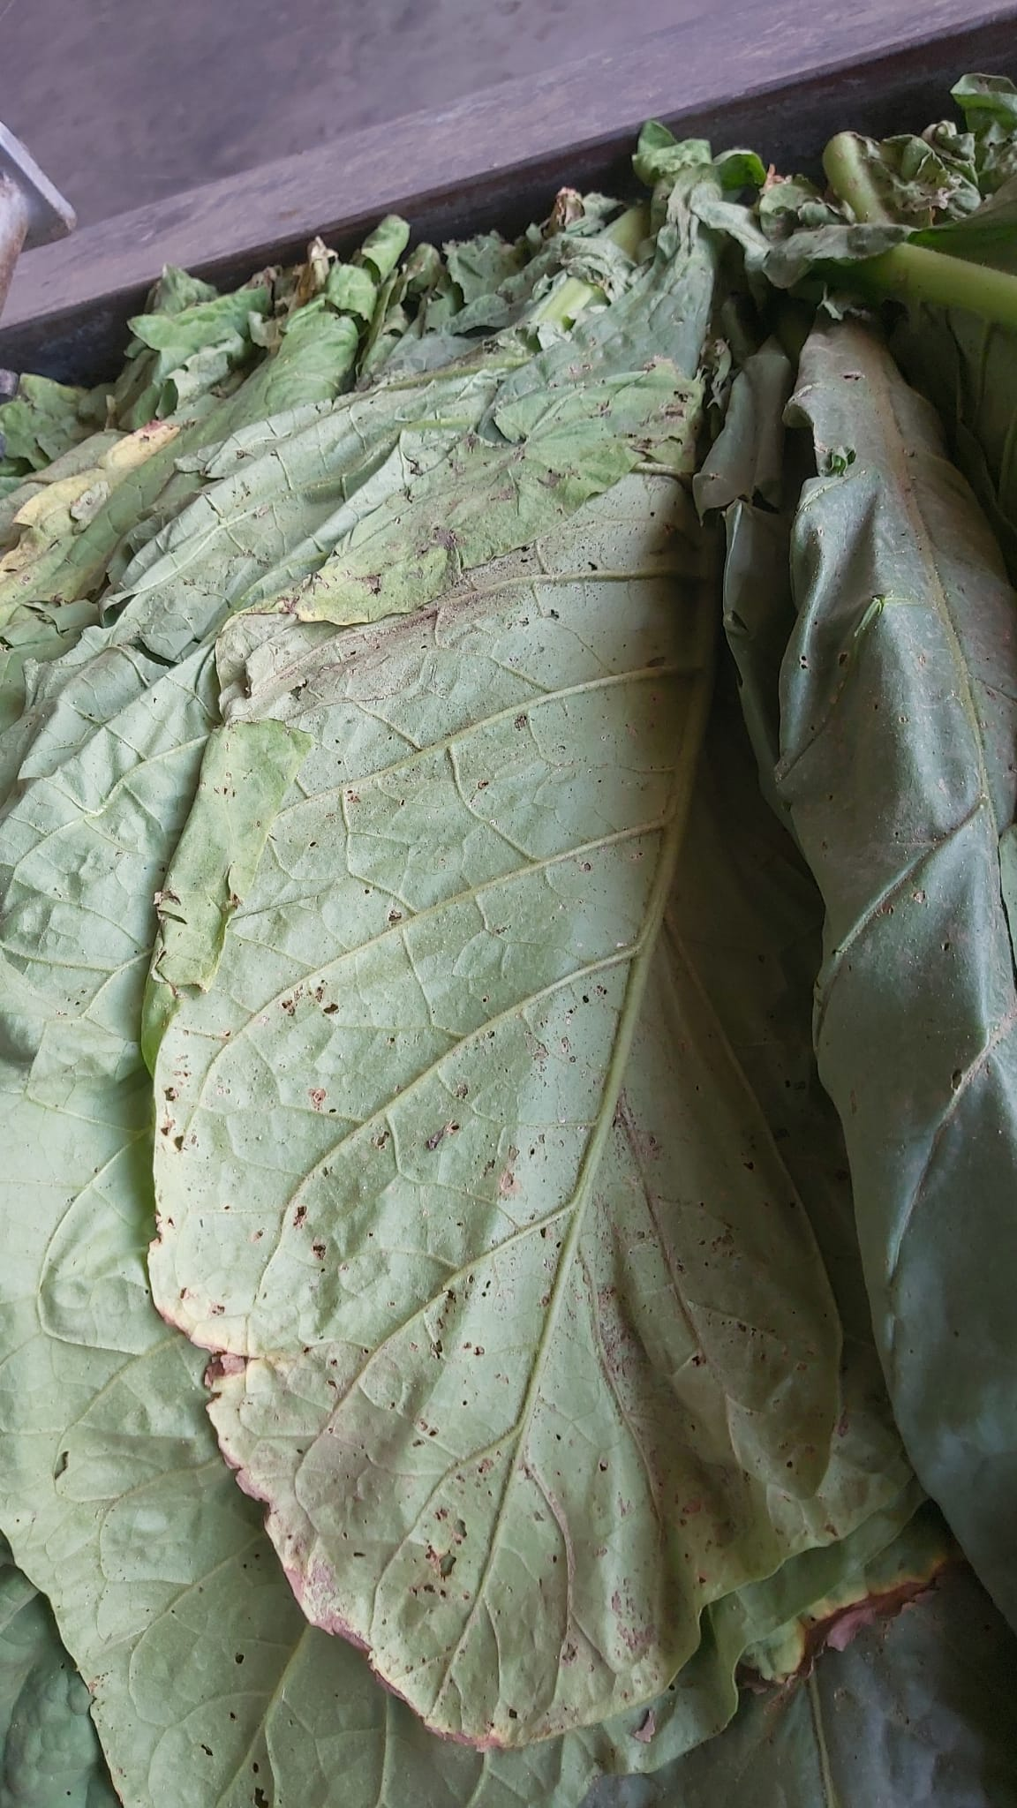
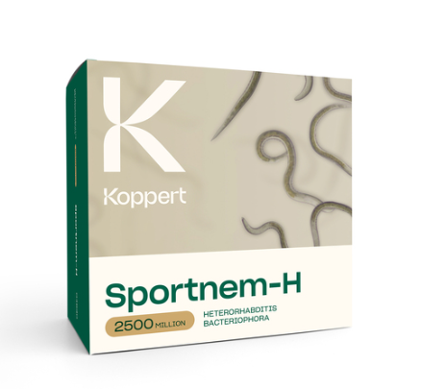
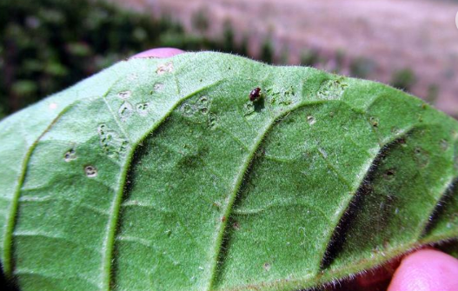
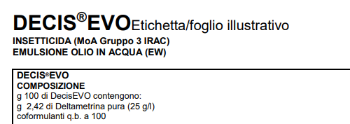
Overview on tobacco plant defense
The tobacco flea beetle - Epitrix hirtipennis
another case study among insects
www.ipmimages.org

Slide 15
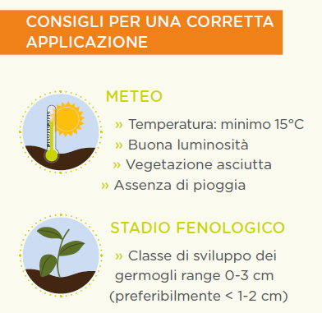
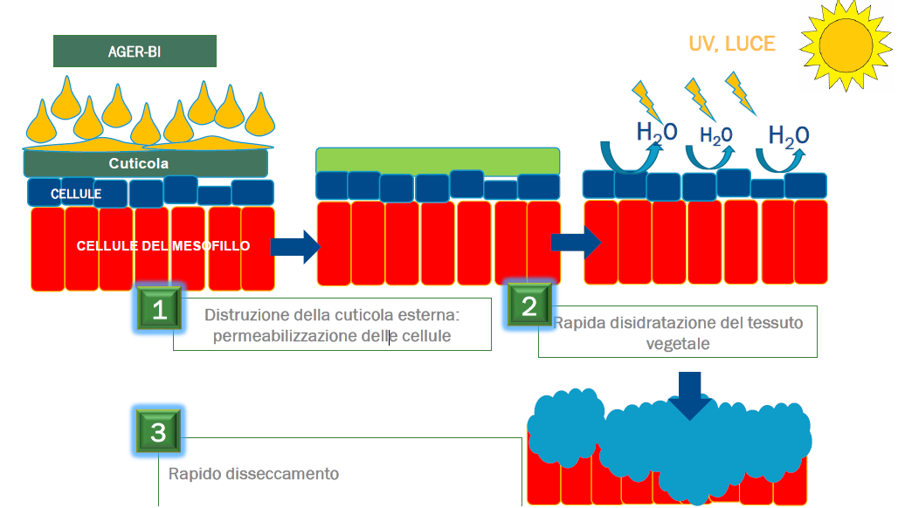
Overview on tobacco plant defense
Suckers control
Experimental trials testing a specific formulation based on pelargonic acid
ADVICE FOR THE CORRECT APPLICATION
WEATHER:
-Temperature: > 15°C
-Good brightness
-Dry vegetation
The external cuticle is damaged
Plant tissues dehydration
PHENOLOGICAL STAGE:
-Suckers growth: 0-3cm
(<1-2cm)
3 HOURS AFTER TREATMENT
Rapid desiccation and drying

Slide 16
Overview on tobacco plant defense
Conclusions and persperctives
EU green policies should take account of the economic sustainability of tobacco farms, considering the side effects of climate change, wars and pandemic
Further economic pressures on European tobacco farmers could lead to the abandonment of this crop, with an increase of imports of untracked and uncontrolled tobacco
Need of facilitated procedures to get an exceptional authorization of an active ingredient for minor crops
Need of investments by agro-chemical companies and Research centers
Reliable agreements with supply chain partners (Coldiretti - Philip Morris Italia – ONT Italia)

Slide 17
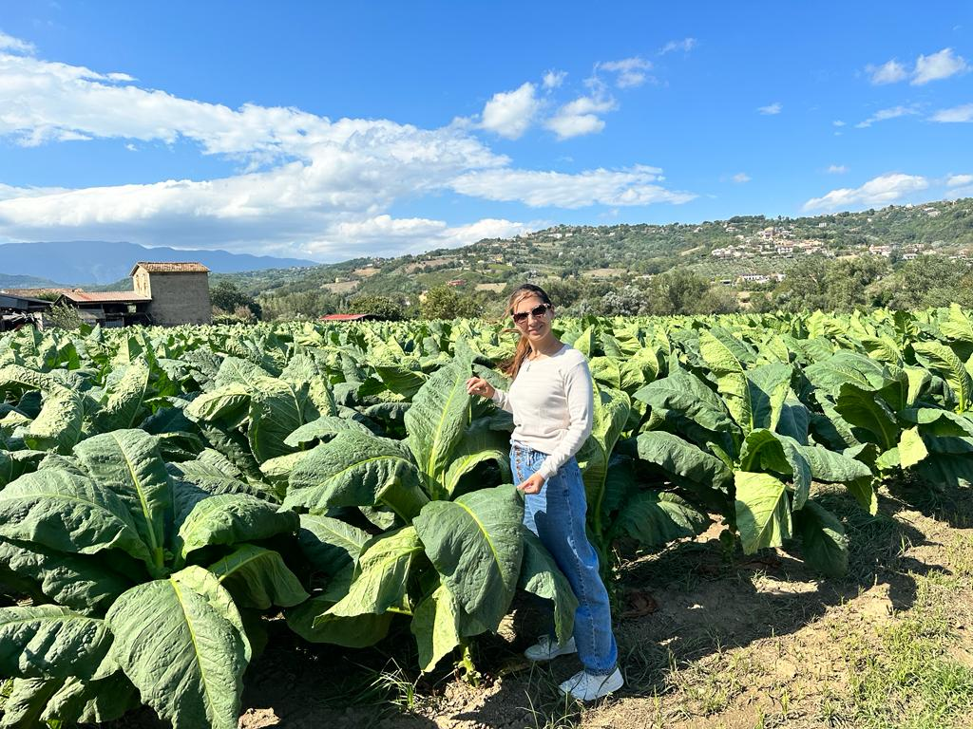
OVERVIEW ON TOBACCO PLANT DEFENSE
ONT ITALIA
Organizzazione Nazionale Tabacco Italia
Legal address: via XXIV Maggio, 43 - 00187 Roma
Administrative office: Via Nazionale, 89/a - 00184 Roma
www.ontitalia.it
05/09/2023, Benevento IT
Martina Cappelletti, PhD
Mail: martina.cappelletti@ontitalia.it
Mobile: +39 348 279 1694
Office: 06 48993 239
Sofija, 26 October 2023

Slide 18
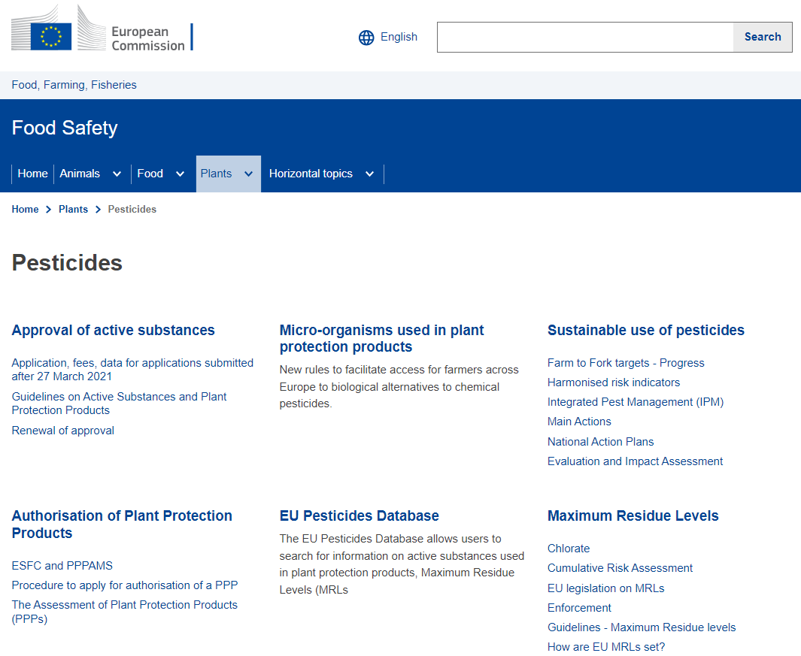
Overview on tobacco plant defense

Slide 19
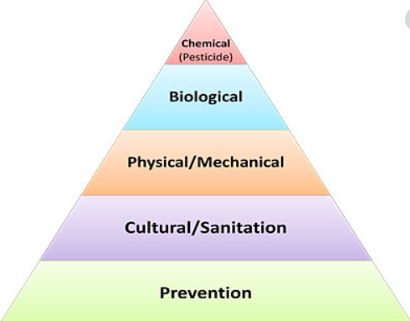
Overview on tobacco plant defense
8 IPM Principles
Prevention the first principle
Monitoring
Thresholds
Non chemical interventions first
As specific as possible mitigating measures
Use of pesticides and other forms of intervention to levels that are necessary
Anti-resistance strategies
Monitor/ check

