Slide 1
UNITAB Congress-Sofia, October, 2023
Raw Tobacco market: European and global

Slide 2
Cigarettes World production
20 Years
6.395
5.714
Source: Universal Leaf Tobacco

Slide 3
Cigarettes World production
20 Years Trends
6.395 in 2012
Peaks
4.010 in 2008
2.585 in 2014
Source: Universal Leaf Tobacco

Slide 4
Cigarettes World Production - World Ex. China
10 years Trend
-620 Bln. Sticks
Source: Universal Leaf Tobacco

Slide 5
Cigarettes World Production - China
10 years Trend
-61 Bln. sticks
Source: Universal Leaf Tobacco

Slide 6
Cigarettes World Production - World Ex. China
5 years variation
First year increase since 2011
+
0
-
∑
-428 BILLION STICKS
Source: Universal Leaf Tobacco

Slide 7
Cigarettes World Production - China
5 years variation
3 years up in a row
+
0
-
∑
+57 BILLION STICKS
Source: Universal Leaf Tobacco

Slide 8
Cigarettes World Production
Trend 2021 vs 2020
In 2021, first annual increase in production since 2011 or 1,22% (+69,1 billion)
World production (Ex-PRC) increased by 1,41% (+45,8 billion)
China production increased by 0,97% Third consecutive year (+23,3 billion)

Slide 9
Cigarettes World Production Top ten cigarrete producing countries
Source: Universal Leaf Tobacco

Slide 10
Tobacco World production
FCV&BUR 10 Years
Crop 23 vs 22:
+378 FCV
+98 BUR
Source: Universal Leaf Tobacco

Slide 11
Tobacco World production
Flue Cured
Source: Universal Leaf Tobacco

Slide 12
Flue Cured production
Exporters
Source: Universal Leaf Tobacco

Slide 13
Flue Cured production
Increases/Decreases (Exporters Est. crop 23 vs crop 22)
+293 mill kg
Source: Universal Leaf Tobacco

Slide 14
EU production
Flue Cured
Source: Universal Leaf Tobacco

Slide 15
World Unsold Stocks - Flue-Cured
Estimated crop 23 up
+11%
3486
Stocks close to the lowest
level of 2013
Source: Universal Leaf Tobacco

Slide 16
Tobacco World production
Burley
+98
The lowest
Source: Universal Leaf Tobacco

Slide 17
Burley production
Increases/Decreases (Est. crop 23 vs crop 22)
+98 mill kg
Source: Universal Leaf Tobacco

Slide 18
World Unsold Stocks - Burley
Crop 23 estimated to increase +28%
353
The lowest stock level
Source: Universal Leaf Tobacco

Slide 19
Conclusions
European tobacco will continue to be important in the market:
Consumption shows a signal of recovery in 2021, but the reduction trend continues.
There are important increases in production volume in crop 23 (and expected in 24).
That increase is expected mainly from areas with high geopolitical instability.
Current ongoing conflict in Ukraine and in Israel-Palestina, will add tension in the market in terms of volume availability, transport and energy cost.
Customers could increase focus on origins with political stability.
Crop 22 was highly impacted by COP increase and unfavorable weather conditions
There is an opportunity to consolidate volumes in EU, but this will only occur if cost keeps within Manufactures expectation.

Slide 20
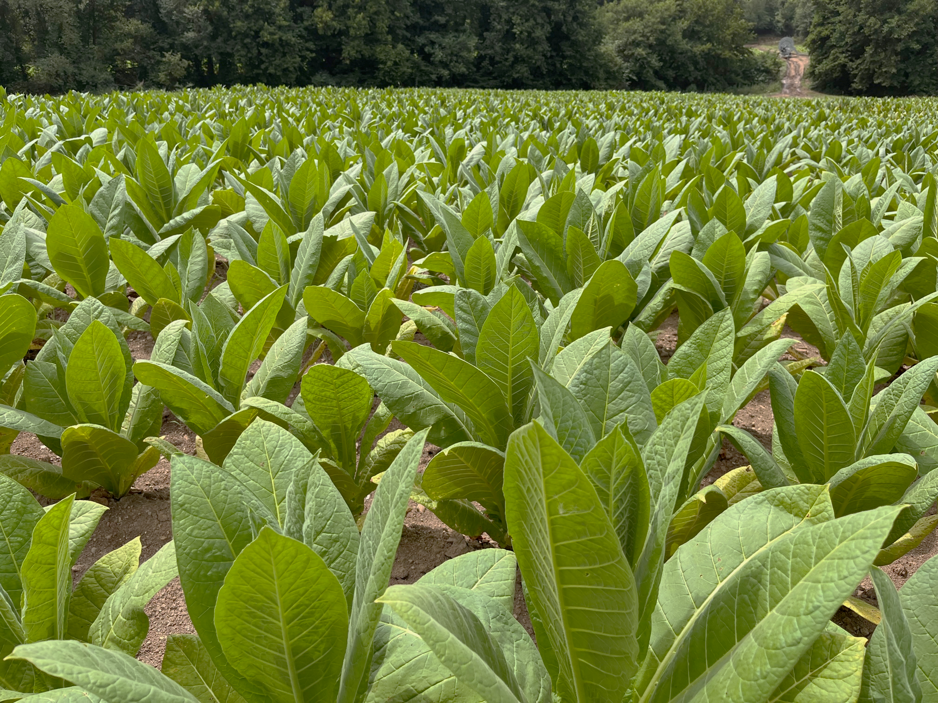
Thank you for the attention!

